Slide 1

OPTIMIZATION RESULTS REVIEW
Performance & Benchmarking
Phase 1 (Deep Search) vs. Phase 2 (Tuned Efficiency)

Slide 2
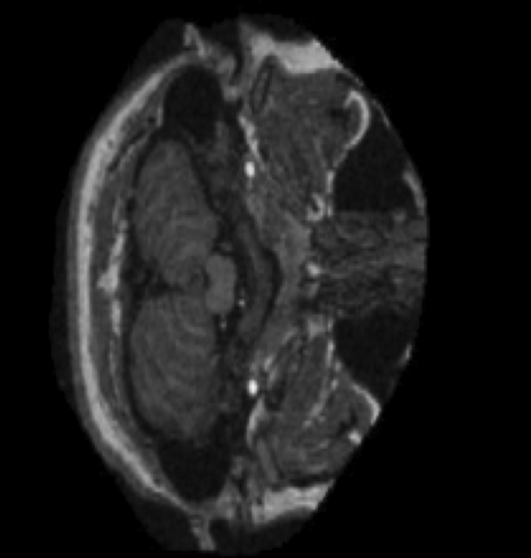

Problem Background
The Challenge: MRI classification
Developing robust metaheuristics requires balancing exploration of search space with exploitation of known optima.
•
High computational cost in standard runs.
•
Necessity for rapid convergence in production.
•
Evaluation of tuned vs. baseline performance.

Slide 3
Algorithm Benchmark Data
Algorithm | Score | Time (s) | Source | Efficiency | Rank
GWO | 0.79488 | 315.84 | Phase 1 | 0.0025 | 1
PSO | 0.78491 | 284.00 | Phase 1 | 0.0027 | 2
BAT | 0.77309 | 359.03 | Phase 1 | 0.0021 | 3
DE | 0.76289 | 380.65 | Phase 1 | 0.0020 | 4
GWO_tuned | 0.67976 | 76.22 | Phase 2 | 0.0089 | 5
WOA_tuned | 0.61616 | 67.42 | Phase 2 | 0.0091 | 6

Slide 4
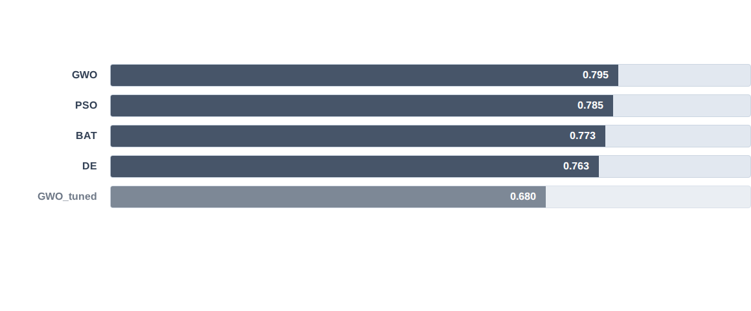
Fitness Score Analysis
Phase 1 algorithms consistently outperform tuned versions in absolute fitness scores.

Slide 5
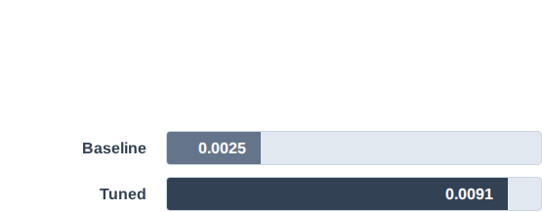
Efficiency Breakthrough
PEAK EFFICIENCY
The Value of Tuning
0.0091
While Phase 1 wins on accuracy, Phase 2 (Tuning) offers a massive 4x efficiency gain.
WOA_tuned (Phase 2)

Slide 6
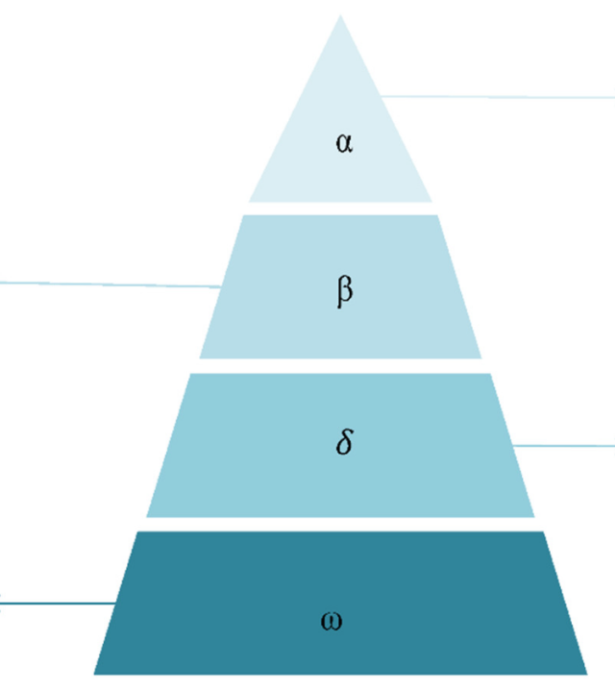
GWO
Top Ranked Algorithm
The Grey Wolf Optimizer secured Rank 1 with a score of 0.79488.
Highest Fitness Floor
Balanced Exploration
Superior Stability

Slide 7
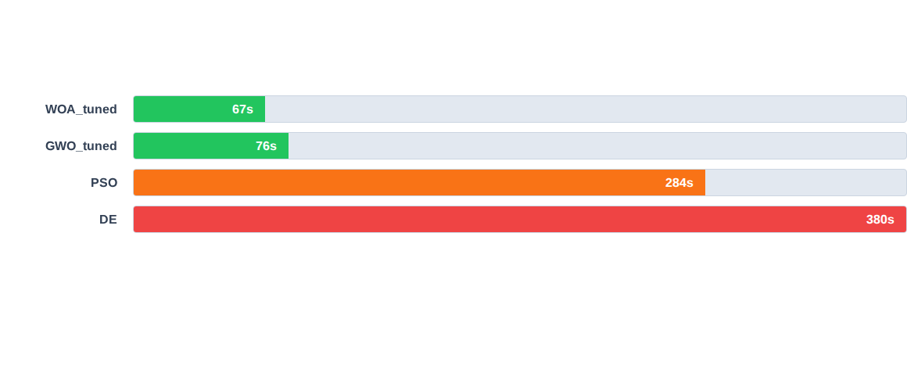
Execution Speed (Time)
Tuned algorithms (Phase 2) are 80% faster on average than deep search baselines.

Slide 8






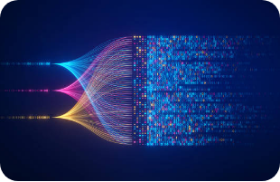


Experimental Visuals
Search Map
Review
Efficiency
Visualization of the high-dimensional convergence space.
Collaborative validation of hyperparameter thresholds.
Optimization of the Score vs. Time trade-off curve.

Slide 9

Conclusion & Verdict
Use GWO, PSO, BAT, DE (Phase 1)
TOP PERFORMERS
Accuracy: GWO (0.794)
Training WOA/GWO using Simulated Annealing (Phase 2)
Speed: WOA_tuned (67.4s)
Efficiency: WOA_tuned (0.0091)

Slide 10
Thank You
QUESTIONS & NEXT STEPS

